Slide 1
Welcome to CS10 Group Sixth Meeting
Team member
Wilma Liu (Leader)
Fiona Hu
Pat Zhang
Elvia Tong
Reehaa Ding
William Quan

Slide 2
This week meeting schedule
Report the last week’s progress and ask for feedbacks
Traveling Problem impact Forecasting
Business Close Support Success Measurement

Slide 3
Project description
NSW Business Disaster Support Forecasting after COVID-19
Main topic:
1) Tourism - focus on impact of similar crisis by modelling
2) Business close - focus on support to crisis by visualisation
Results:
1) Analyse social and economic cost and impact of similar crisis
2) Provide measurement and recommendation of business support

Slide 4
Travelling problem impact forecast
The reason why investigate tourism problem
1) Direct and indirect losses to tourism industry and whole economic system in Australia and NSW
2) The main seasonal income for unskilled labour, especially for lower income groups
Demonstrate the change of international arrivals of short-term visitors by using visualisation
Implementing LSTM model to predict estimated recovery time period that reach the pre-crisis level. Uses historical data to provide insights.

Slide 5
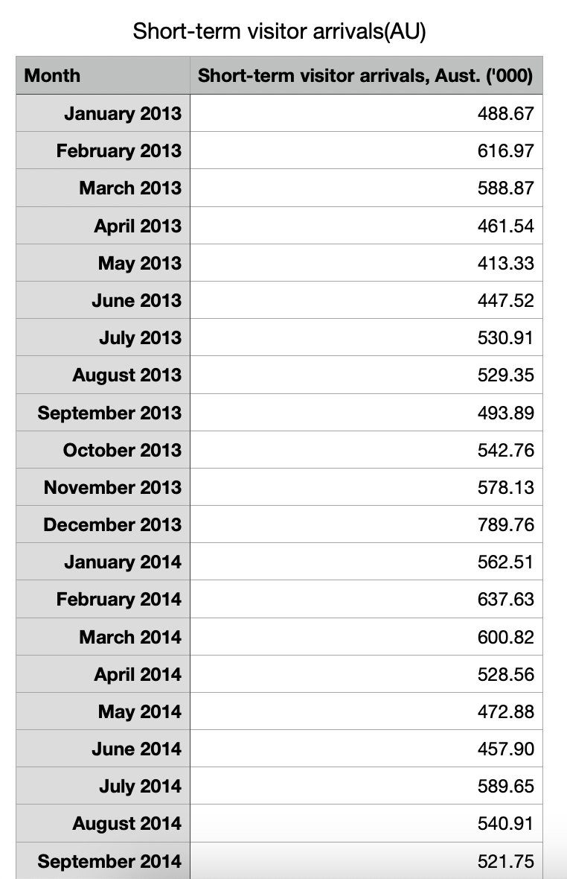
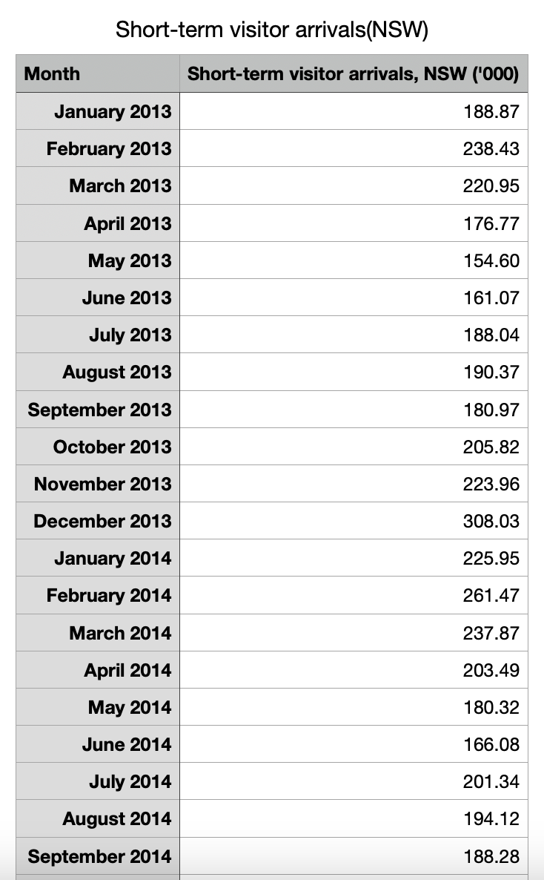
Travelling problem impact forecast - Dataset
Short-term visitor arrivals of Australia and NSW

Slide 6
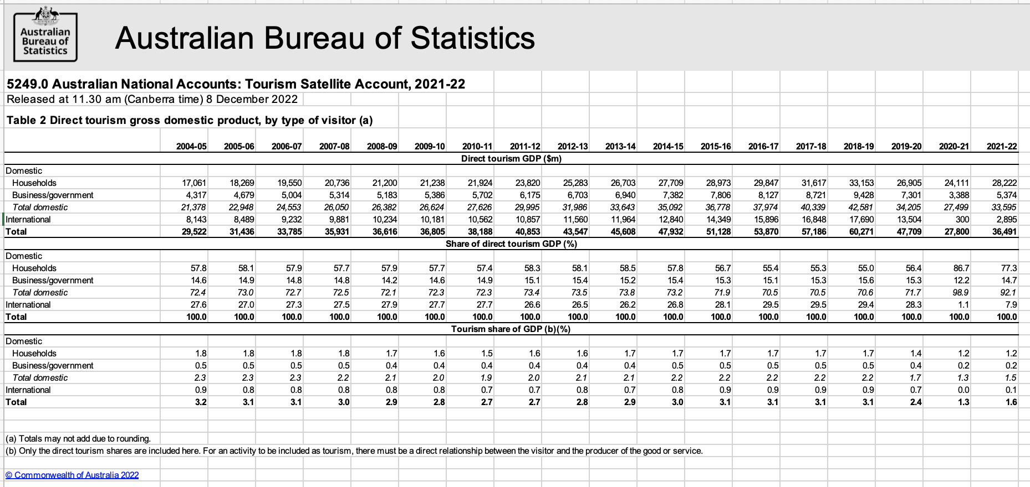
Travelling problem impact forecast - Dataset
Travelling consumption data, including direct tourism GDP, direct tourism output, direct tourism GVA and so on…

Slide 7
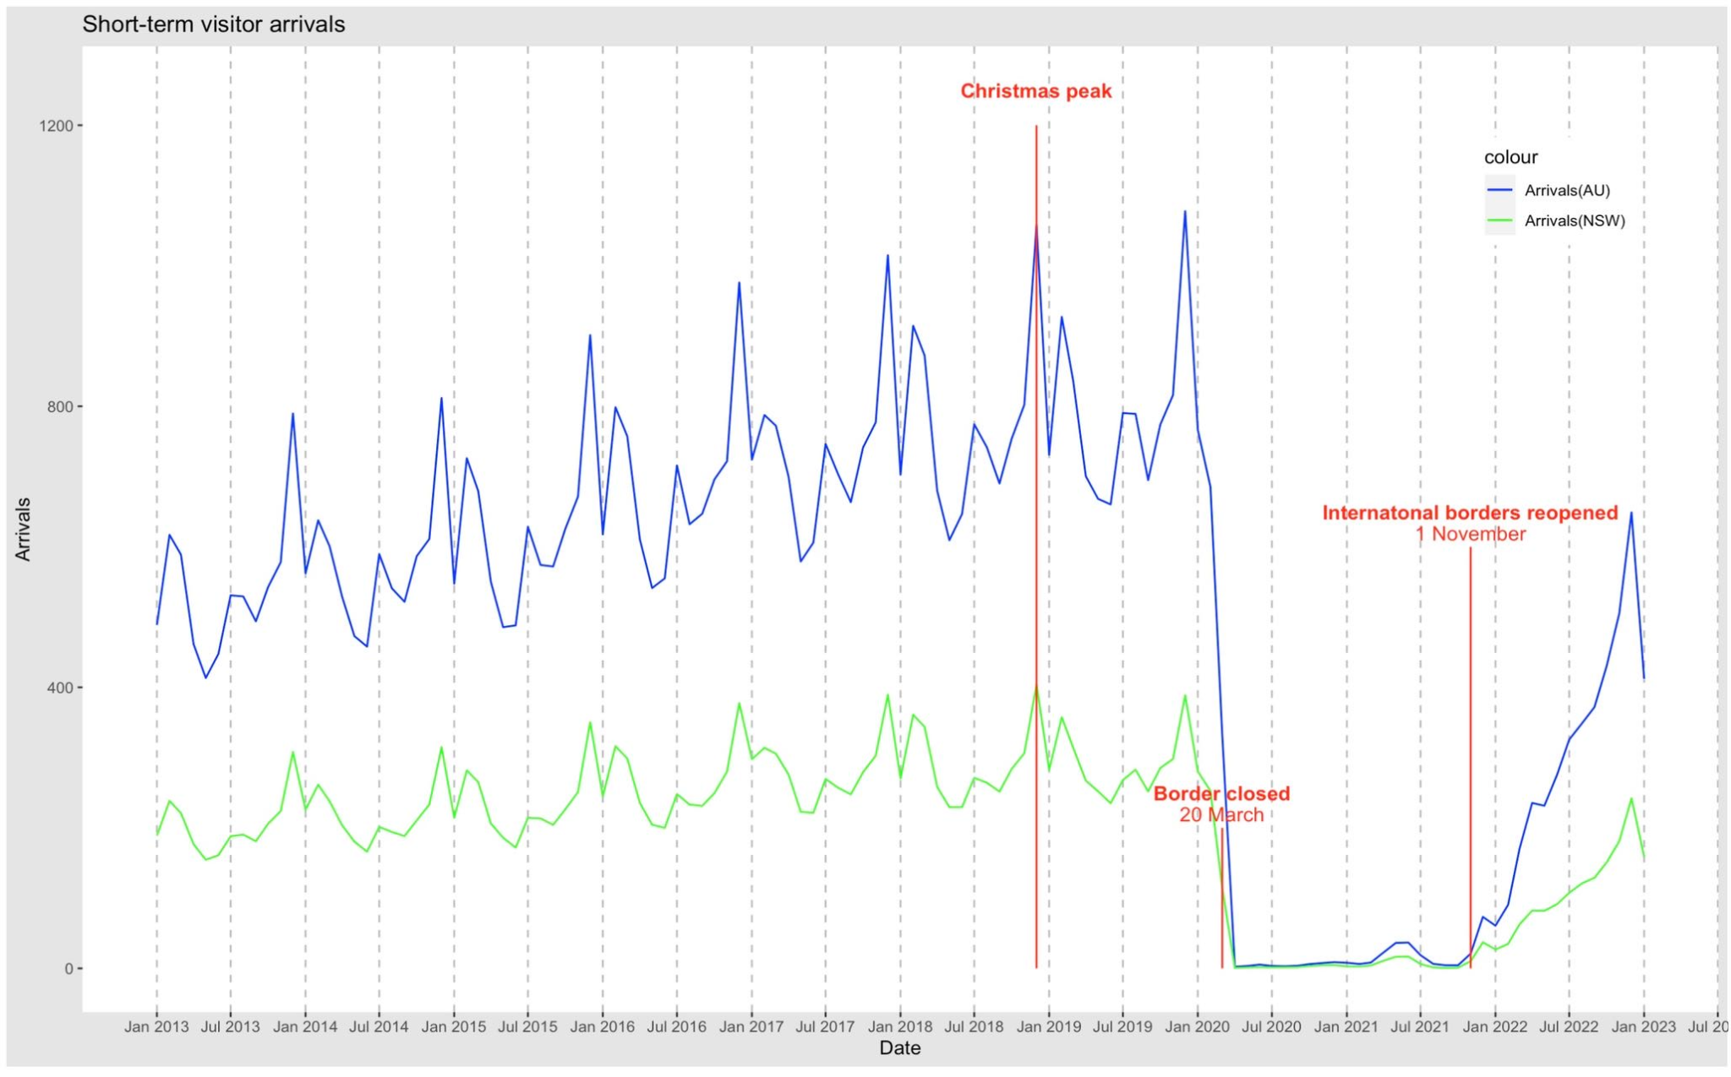
Travelling problem impact forecast- Visualization

Slide 8
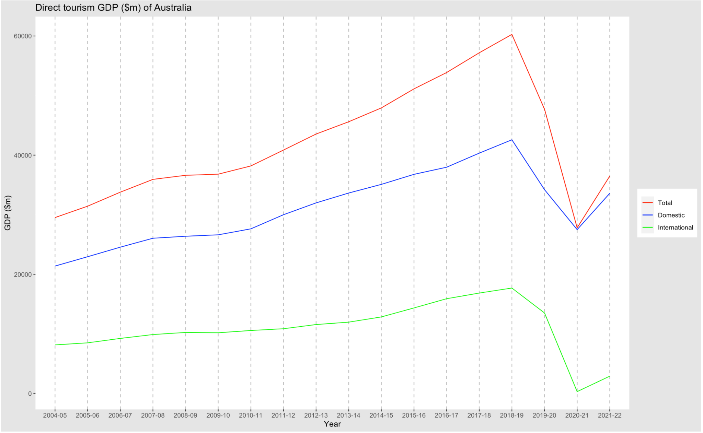
Travelling problem impact forecast- Visualization

Slide 9
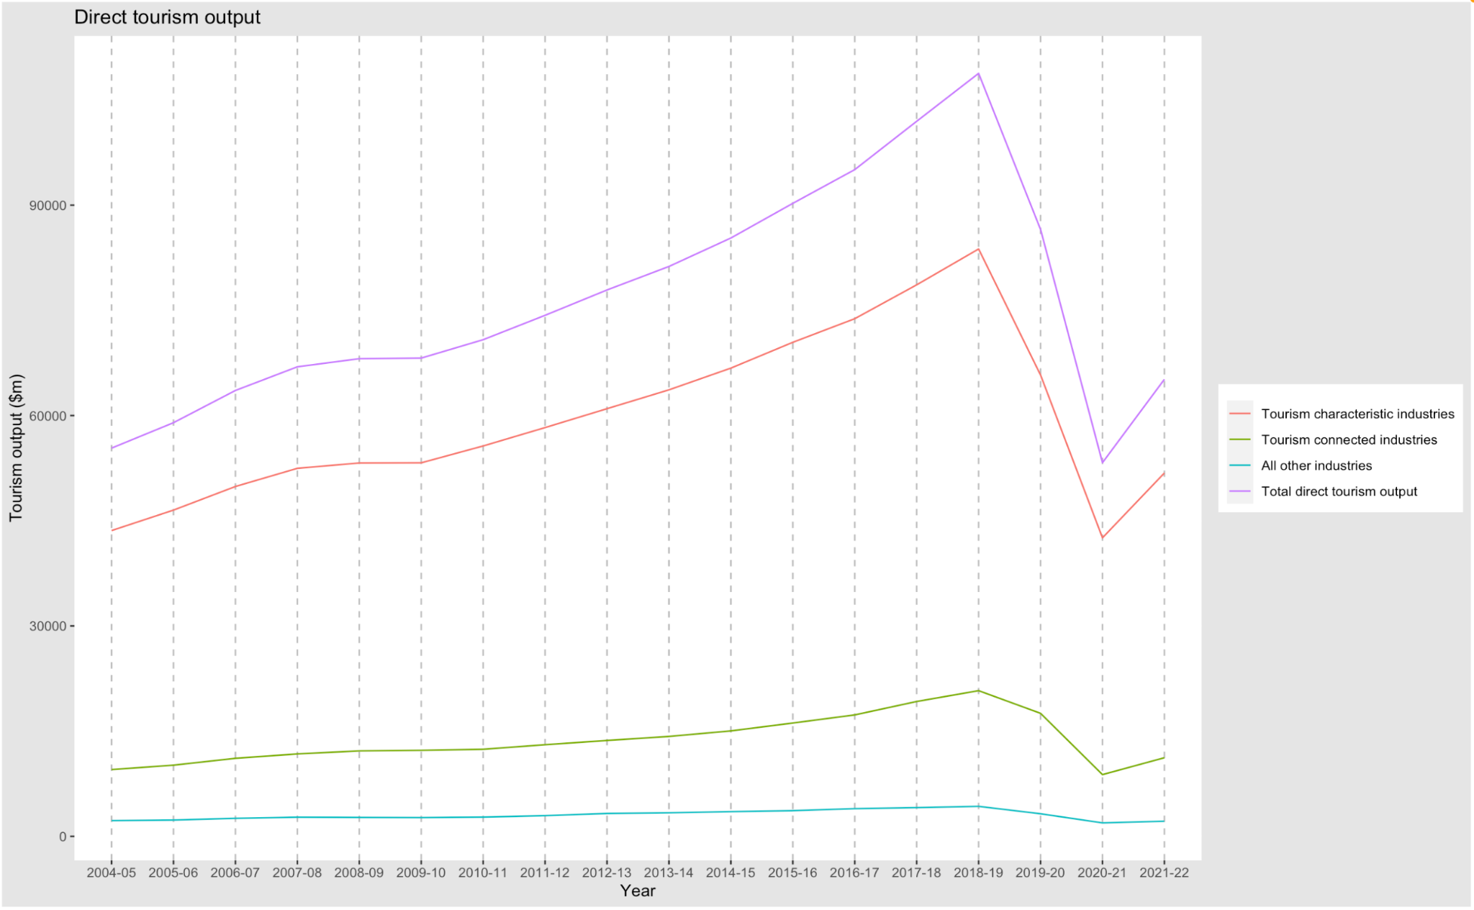
Travelling problem impact forecast- Visualization

Slide 10
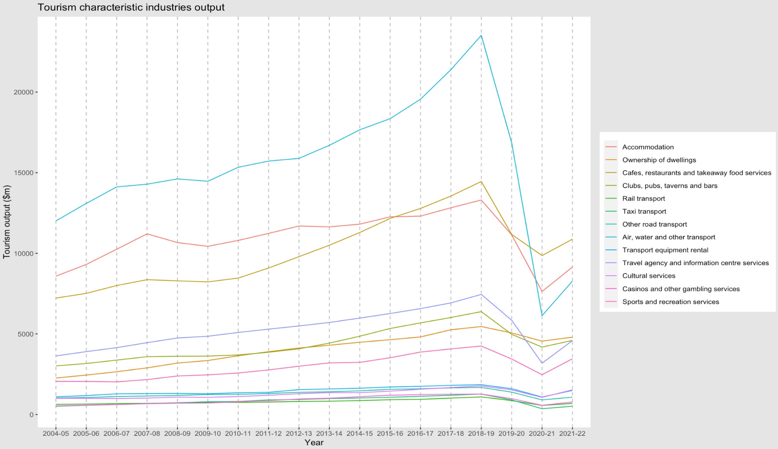
Travelling problem impact forecast- Visualization

Slide 11
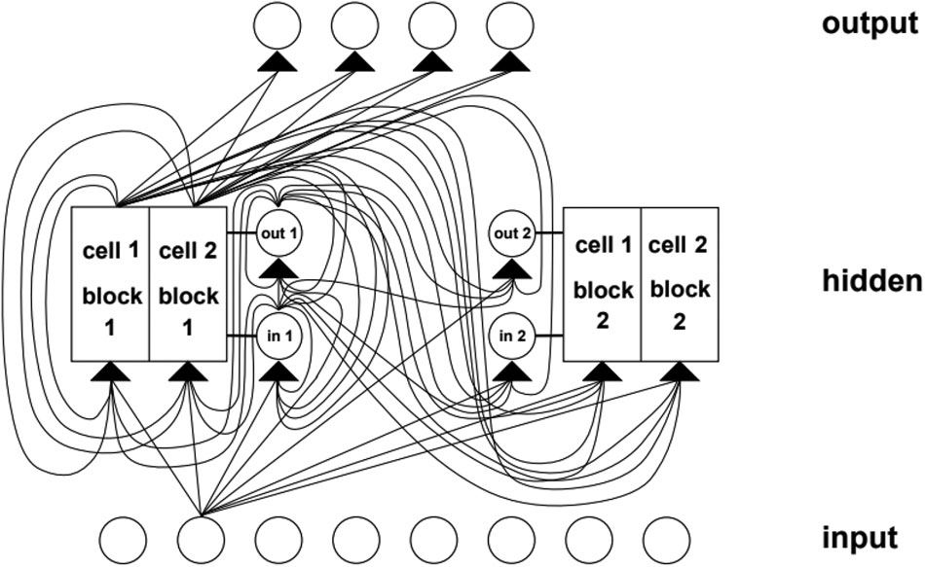
Travelling problem impact forecast- Model
The number of arrivals
1) Monthly data
2) From SARS to Covid-19
LSTM model for time series data
1)Autocorrelation proof
2)Sensitivity analysis
3)Backtesting for robustness
4)Backward fitting and forward prediction

Slide 12
Travelling problem impact forecast- Expected outcomes
Impact
The influence of the epidemic on the tourism industry (especially changes in the number of tourists)
Model Output
Predicting the number of international travelers arriving in NSW per month
Outcomes
Compared the predicted travellers with the number of travelers before the epidemic. If the result can not reach the baseline, study how long it will take to return to normal levels; If it has reached or even exceeded the baseline, compare the growth rate with that before the epidemic.

Slide 13
Travelling problem impact forecast- Risk
Risk
Insufficient data affects the model fitting accuracy
Limitation
SARs is not the same as Covid-19
The forecasting results are affected by Australia’s policy like restricting border entry and opening up to business
Depends heavily on the resolution(vaccine) date of the current pandemic

Slide 14
Travelling problem impact forecast- Feedback
Any improvements or suggestions on travelling problem impact forecast

Slide 15
Business Close Support Success Measurement
Interactive Dashboard Visualizations (BA,DA)
Identifying Trends of the success of supporting business with different Business sizes and Turnover (Narrow Down)
Business Counts Operating in 2018, Survival in 2019-2022 by different industries
Business Counts Entry in 2018, Survival in 2019-2022 by different industries
Business Counts Survival in 2020-2022 by different industries and regions
Python Automated Visualization (DS)
Automated Visualization generation- Flexibility and Reproducibility

Slide 16
Business Close Support Success Measurement- Past Government Support For The Business
Support Name | Date | Business Size | Turnover
$10,000 small business support grant (2020) | Mar 2020 | 0-20 | Less than 50k
$3,000 small business recovery grant (2020) | July 2020 | 0-20 | Less than 50k
Micro-business grant | July 2021 | 0-20 | Less than 50k
JobSaver payment | July 2021 | 20+ | Over 50k
Business grant | July 2021 | 20+ | Over 50k
Small business support grant | Feb 2022 | 0-20 | Less than 50k

Slide 17
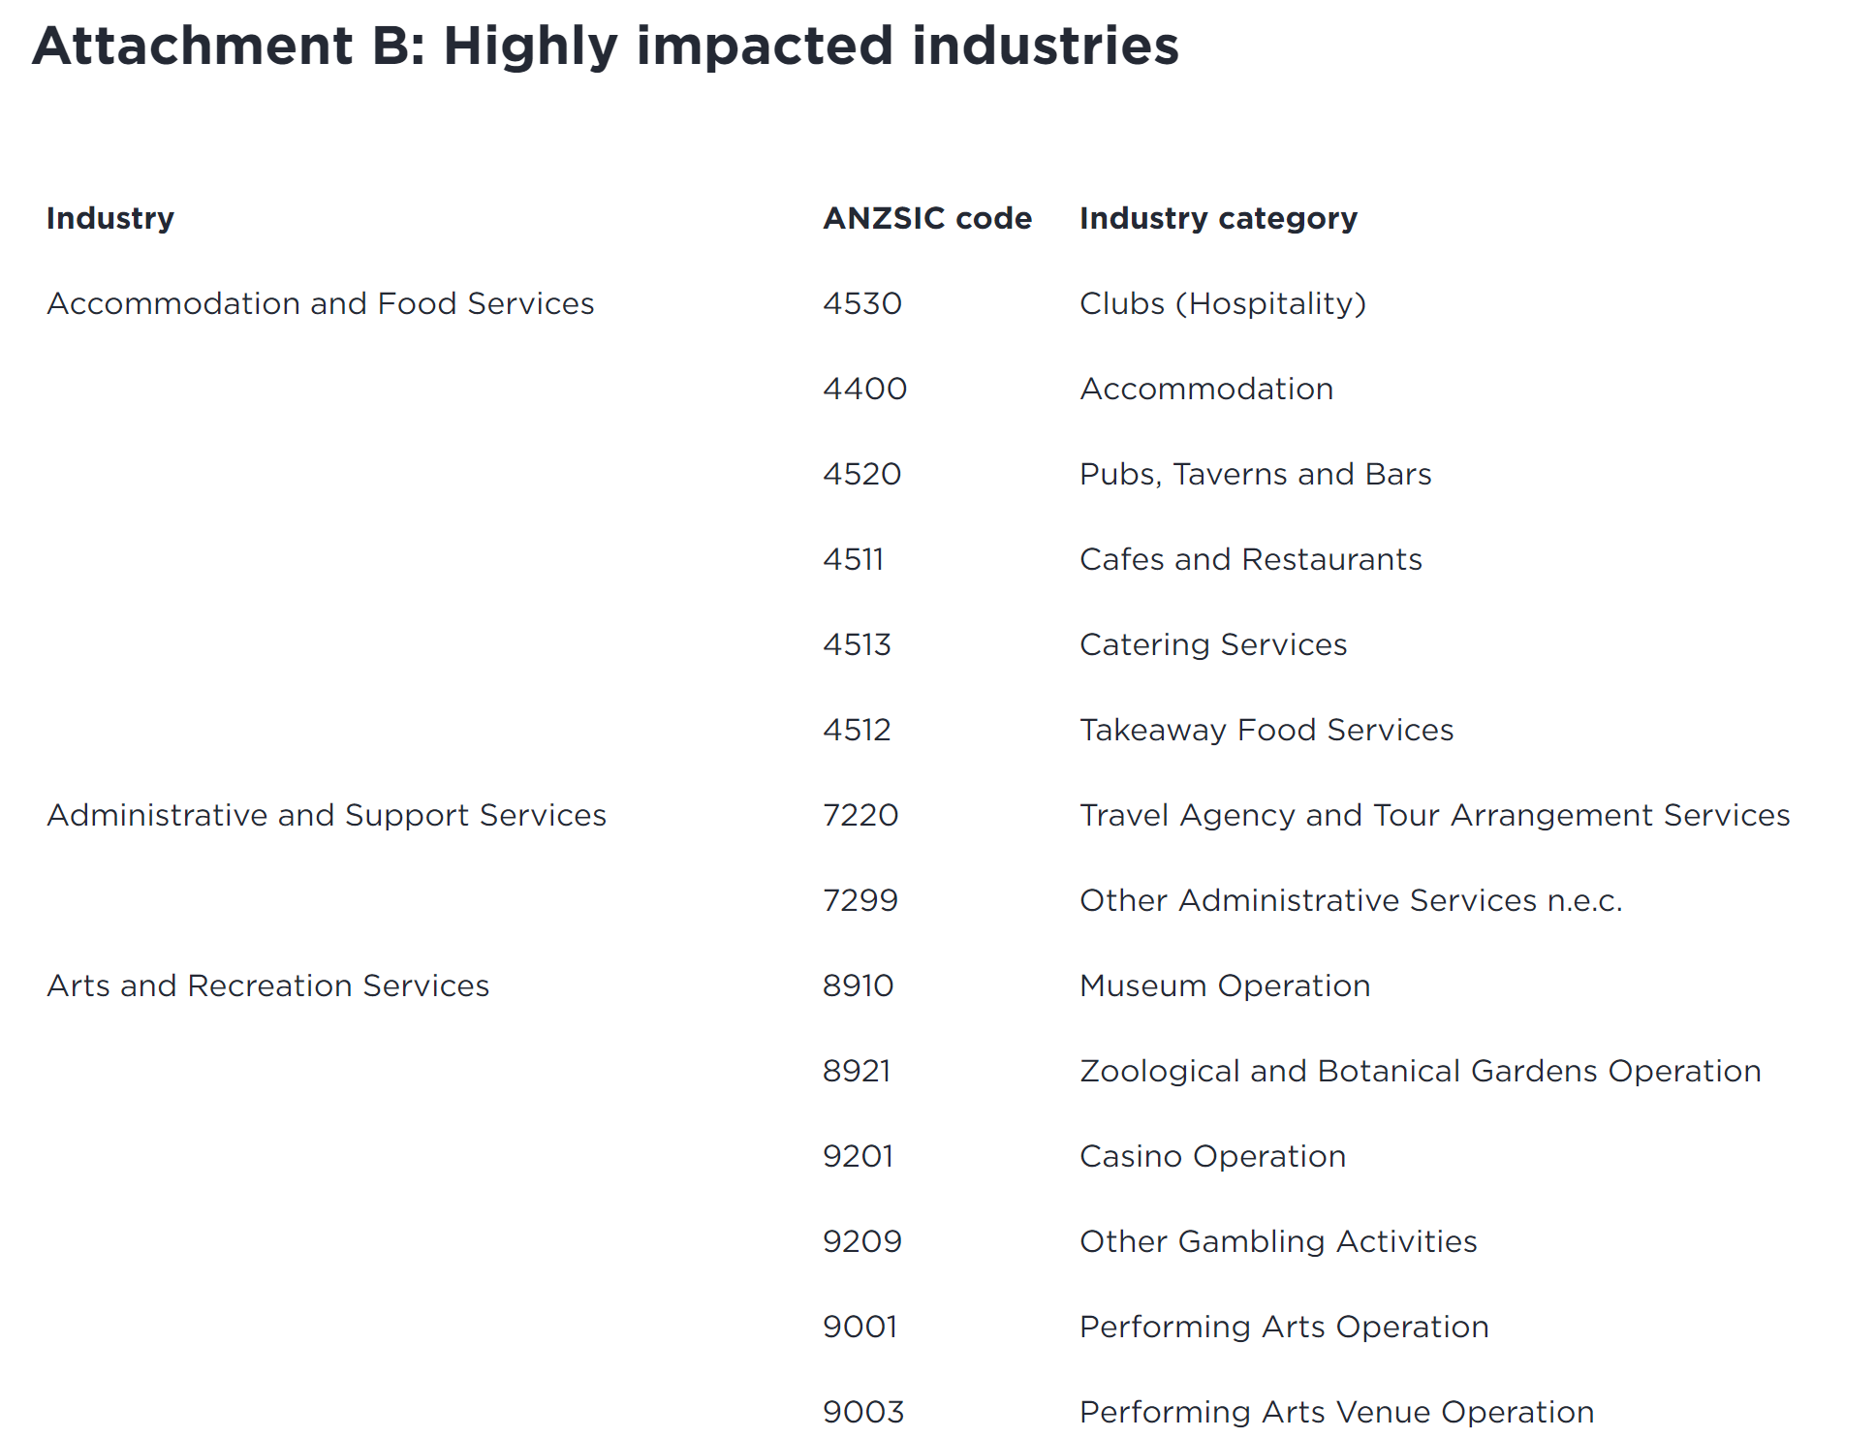
Business Close Support Success Measurement- Past Government Support For The Business

Slide 18
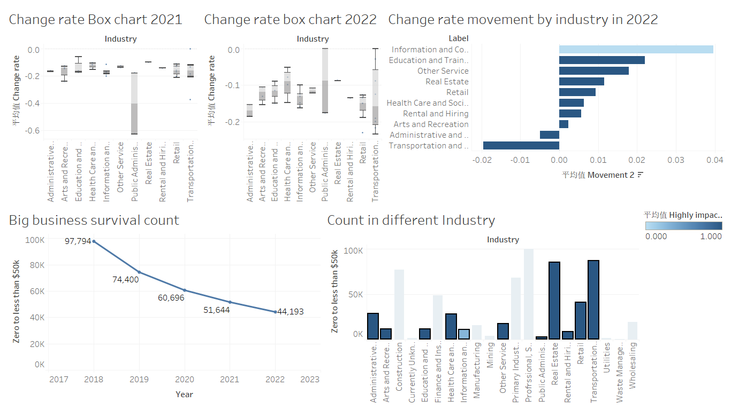
Business close support success measurement- Tableau visualization Based on Operating small businesses

Slide 19
Business close support success measurement- Python Automated Visualization

Slide 20
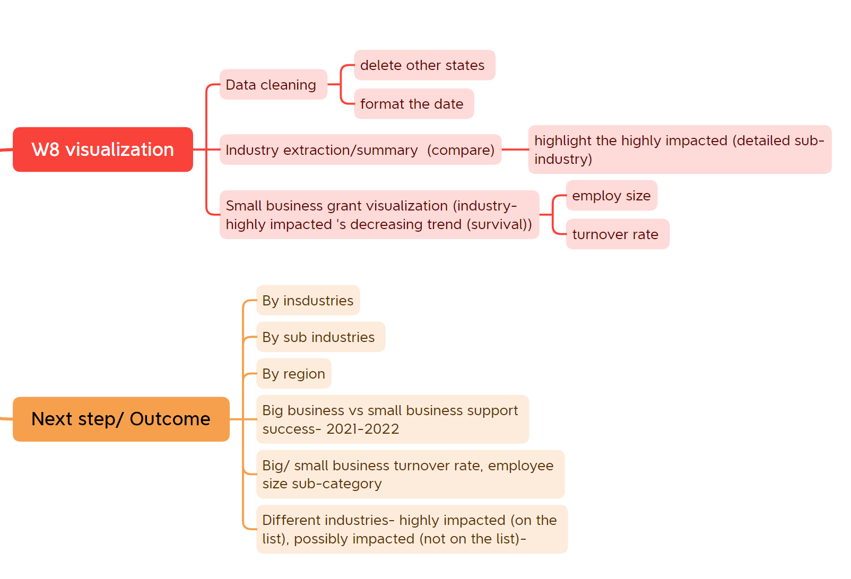
Business close support success measurement- Progress and Next Step (Expected Outcomes)

Slide 21
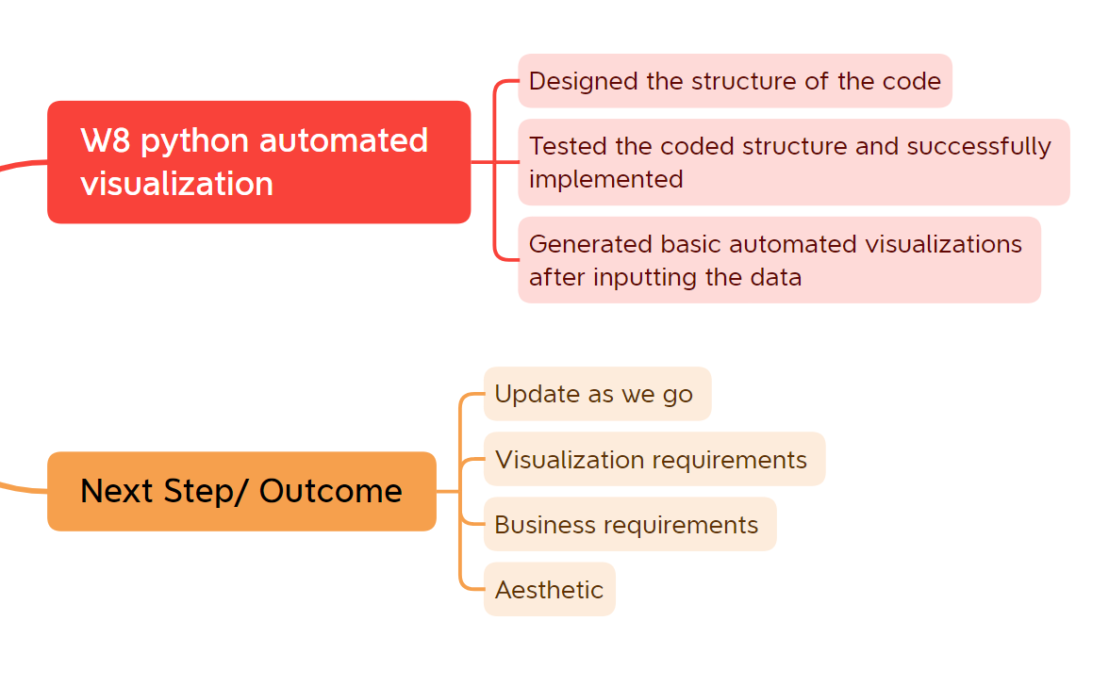
Business close support success measurement- Progress and Next Step (Expected Outcomes)

Slide 22
Business close support success measurement- Risk
Assumptions based support measurement:
Eligibility- Turnover decrease, Turnover rate/ Employee size ranges, and highly
impacted industries.
Support impact Time range- 2020 Mar applied, Measure on 2020 June.
Success criteria definition- Business exist/ Survival.
Highly impacted business by Covid-19- Contradiction

Slide 23
Business close support success measurement- Feedback
Any improvements on Business Close Support Success
Measurement

Slide 24

Thank you !!!

